Slide 1


Notes:
Bachelor of Science in Computing
My chosen specialisation was networking and mobile

Slide 2
Alex Quigley | 10205691 | BSHCE 4 | Networking & Mobile
Notes:
Bachelor of Science in Computing
My chosen specialisation was networking and mobile

Slide 3

Alex Quigley
10205691
BSHCE 4
Networking & Mobile

Slide 4
OVERVIEW
Background
Repositories
Concurrency
Security
File Tokenization
Notes:
Benefits and Complexities of repositories
Concurrency Controls
File Security
File Tokenization/Abstraction – Globes…

Slide 5
OVERVIEW
Globlock
Why Globlock
Demonstration
How it works
Notes:
How is Globlock a solution
Give Demonstration
Before technical aspects of Globlock…

Slide 6
OVERVIEW
Globlock
Reflection
Questions
Notes:
And finally, a reflection on the project as a whole
AND
hopefully have an Answer for any questions

Slide 7
REPOSITORIES
Repositories
Multiple Documents
Multiple Revisions
Central Location
Notes:
A repository stores files and documents, at multiple revisions
All stored in central location
Available when needed
Obvious benefits to a repo, prevent duplication if used correctly, central store, historical revisions
But they do have drawbacks

Slide 8
REPOSITORIES
Github
Command Line
Requires Technical Skill
Difficult to Manage & Track
Notes:
Example repositories include github
Which has a command line
However, It requires technical skill to use and manipulate
Although a GUI version exists it still feels complex and unfriendly to most users

Slide 9
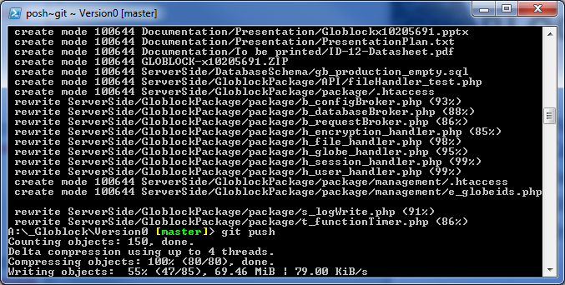
REPOSITORIES
Notes:
Most people outside of developers see this and scream
Yes, developers do love it, in fact I love it myself
It was used for the project
But when I first started to use it I was scared too
Couldn’t call it user friendly and certainly not intuitive

Slide 10
REPOSITORIES
Dropbox
Share requires steps
Who has access
Difficult to Manage & Track
Notes:
Dropbox is another example
In order to share files, you need to email a link or something
And after sharing 4 or 5 different folders with different people,
you never really know who has access to what. Certainly not without digging

Slide 11
REPOSITORIES
Repositories add..
Needed central location for files and file revisions
Layers of complexity, difficulty, time
Notes:
REPOS ADD:
In business, documents need strict controls. Controls that repos facilitate for a group of users.
*REPOS ALSO ADD
Layers and layers of complexity, difficulty and increase the time it takes to successfully manage documents

Slide 12
CONCURRENCY
Concurrent Access
One file one user
Single, latest revision
File security and control
Notes:
On the issue of concurrency control,
Not everyone in the business world needs write access a file concurrently while others have access
I don’t want Barry in work making a change to the EOS report without me updating it first
Sometimes people just want a single file at the latest revision
Multiple access point leads to increased security vulnerability, and this loosens the controls on documents

Slide 13
SECURITY
File security adds…
Improved management and structure
Additional costs, complexity and time
Notes:
In order to have full control, and remove risk, you need file security
FILE SECURITY PROTOCOLS ADD
Improved management and structure to document repos
*BUT IT COMES AT A COST
Complexity, Difficulty and Time

Slide 14
ABSTRACTION
File abstractions
Physical Possession
Physical Handover
Responsibility
‘Pass the baton’
Notes:
Now just a little about the physicality of a document
*PHYSICAL possession has value, outside of plain old possession.
The physical *HANDOVER of a document has meaning. More so than just emailing or storing a soft copy.
It’s almost as if it has greater IMPORTANCE
Physical possession is about a different level of *RESPONSIBILITY
*PASSING THE BATON TO SOMEONE IS NOT TAKEN FOR GRANTED
…..
THERE IS A SOLUTION

Slide 15
The Solution…
GLOBLOCK
Notes:
You heard it here first

Slide 16
SECURE
System Architecture & Physical Design:
2 Factor Authentication
Notes:
GLOBLOCK IS SECURE
How the system is physically designed
And how its architecture is structured
*ENABLES 2 factor authentication
BY DEFAULT, without overheads normally associated increased security

Slide 17
CONCURRENT
The systems very nature and structure enforce concurrent access control
Notes:
SINGULAR ACCESS
The systems very nature enforces strict, singular access controls

Slide 18
SIMPLE
File repository
Central Location
Full revision storage
Notes:
ITS SUPER SIMPLE – It does few things, really really well!
It’s a file repo
In a central location
With full revision backup

Slide 19
SIMPLE
No overheads
Intuitive
No complexity
Notes:
It’s simple
No complicated overheads and cost
Its intuitive from first use
No complexity whatsoever from the users point of view
*ABSTRACT* And this is where the abstraction comes in

Slide 20
ABSTRACT
So simple…
You won’t even realize you’re using it
Notes:
It’s so simple, you wont even know your using it
……
*DEMO*

Slide 21
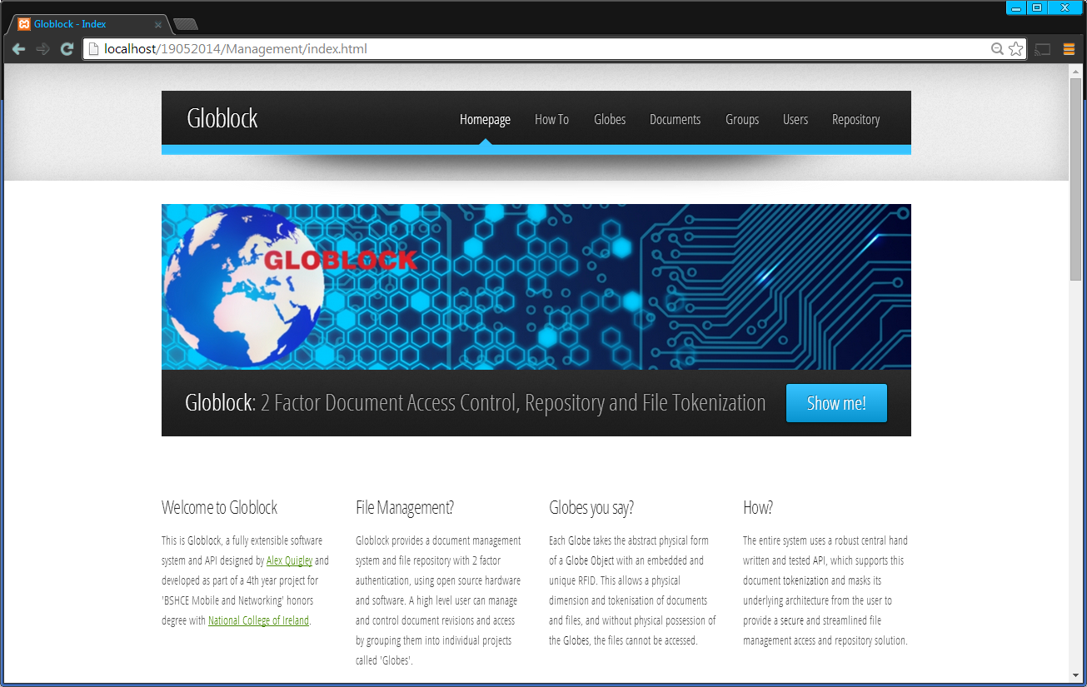
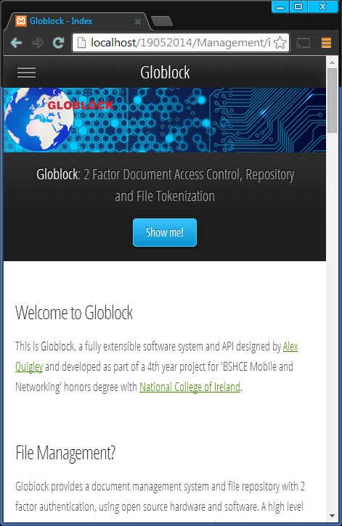
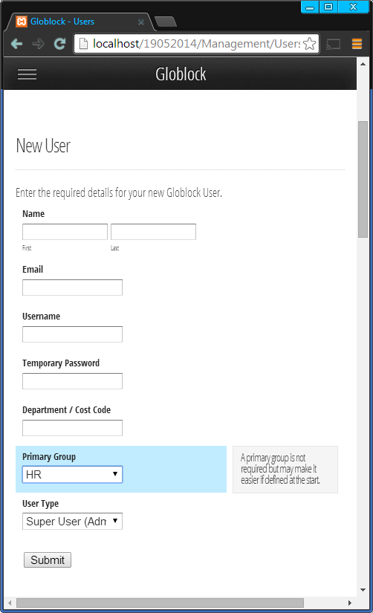
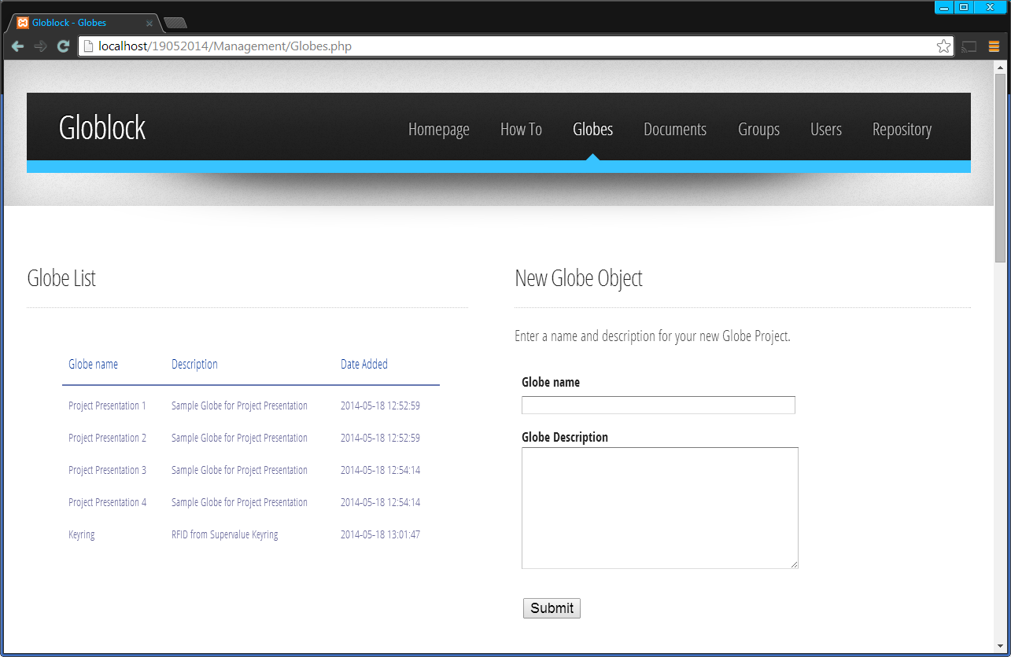
DEMO
Management
Web Application
Notes:
I will give a demonstration now
Start with Management application adding some documents and general interaction

Slide 22
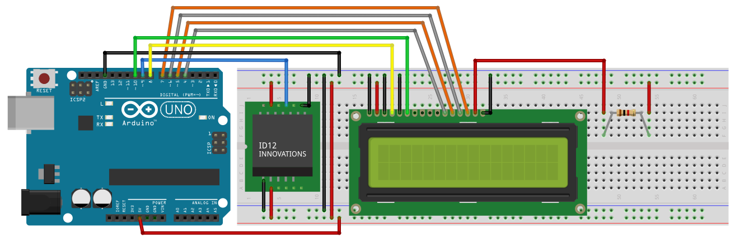
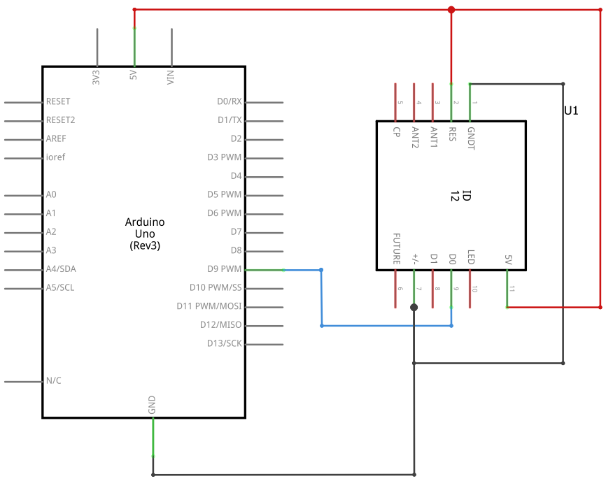
DEMO
Hardware
Interface
Notes:
I’ll interact with the hardware interface
*API*

Slide 23
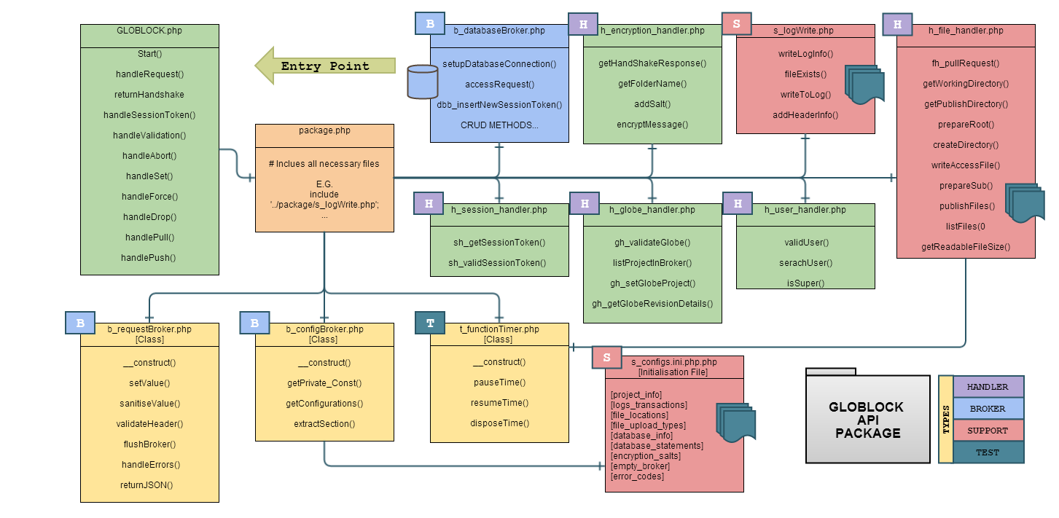
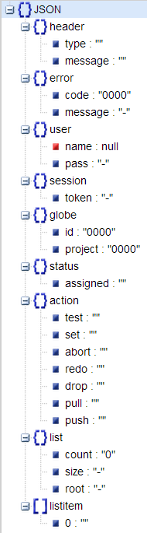
DEMO
Core
API
Notes:
And then you will see the core API in action
WARNING
The entire system is a simple and uncomplicated process for the user
But that’s not to say the underlying architecture isn’t.
It’s complicated, so the user interaction isnt.

Slide 25
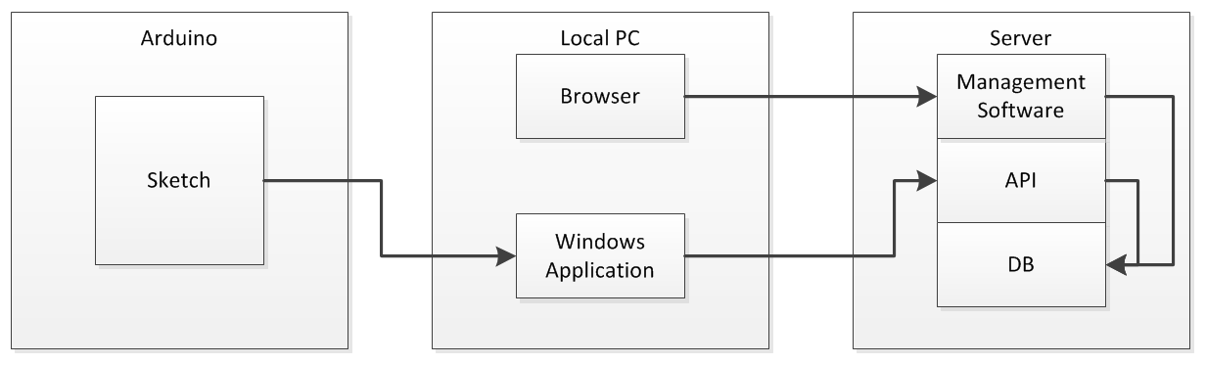
DECODED
Notes:
Arduino Device that Reads RFID
Local PC
Browser to interact with Web Application
Windows application which accepts communications from the reader and sends requests to the API
Server
Hosts Web application
API
Database

Slide 26
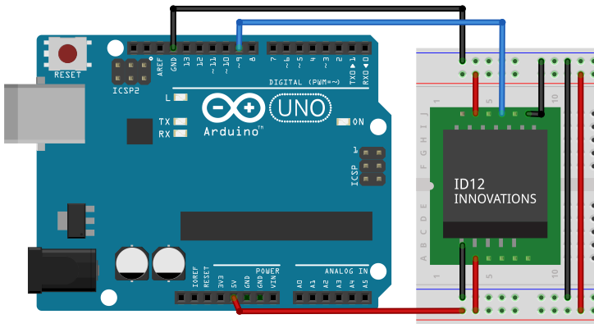
Notes:
Arduino UNO R3 – ATMEGA chip
ID-12LA, internal antenna, range of approx 120mm

Slide 27
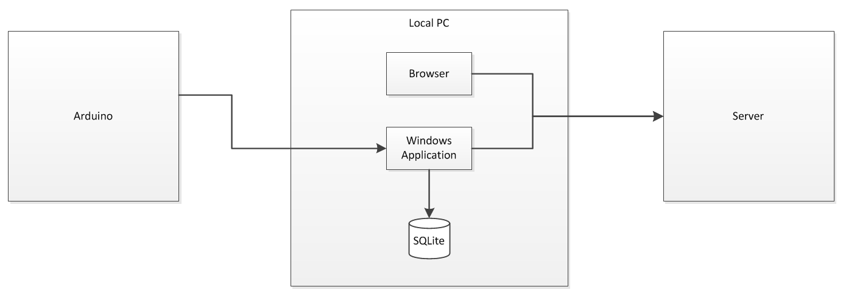
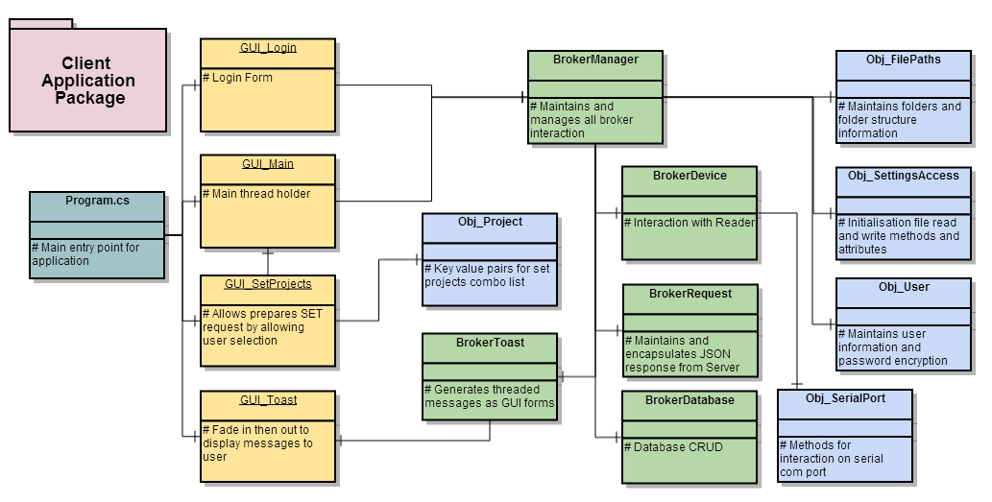
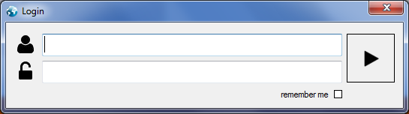
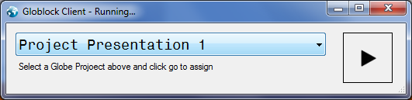

Notes:
Closer looks at the local PC, very few interactive elements
As I said, everything happens in the background, so the architecture is masked

Slide 28
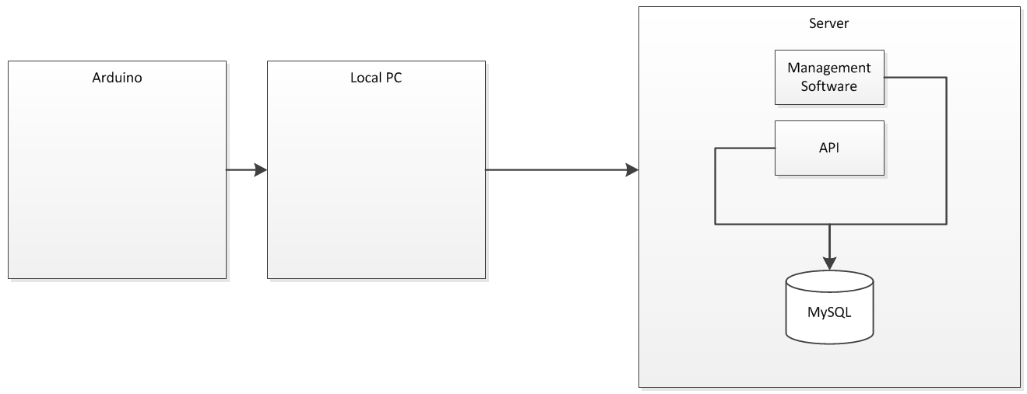
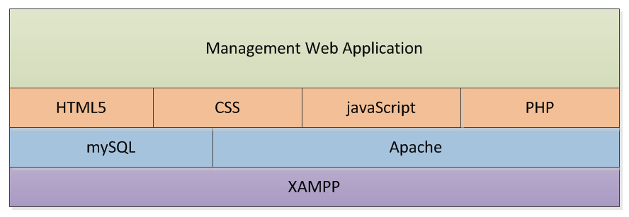
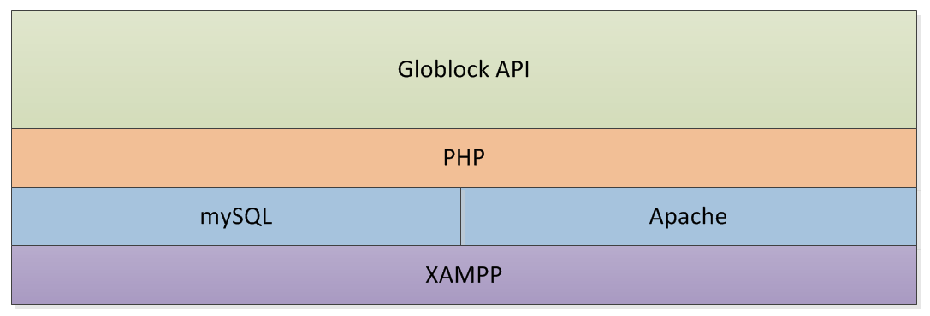
Notes:
Web Application sits on a LAMPP stack, in this case XAMPP
Web front
MySQL Database
Apache HTTP server
API built in PHP also rests on the XAMPP stack

Slide 29
HANDSHAKE
Is SERVER alive
SESSION
Authentication/Activity Lifecycle
VALIDATE
Validation & Available Actions
ABORT
Disposes of Session Token
SET
Associates an Physical Object
DROP
Drops an Association
FORCE
Overwrites Association
PULL
Pulls files down from Server
PUSH
Pushes files up to Server
Notes:
HANDSHAKE to see if the server is alice
SESSION – this is the first and only time username and password are needed for a complete cycle
Activity cycle, allows a session token to be used a limited amount of times, the first of which has to be validation
Anything after validation, then the session reaches full cycle and is dropped and can’t be used
VALIDATE – validates a globe object and returns list of possible further actions/requests
SET – assigns/associates a globe object with a particular globe project (group files)
DROP and FORCE – Remove association or overwrite an association
PULL – Downloads associated documents for the globe object
PUSH – Uploads associated documents for the globe object, with changes intact
EVERYTHING!!! EVERY REQUEST TO THE SERVER ENVOKES A JSON RESPONSE
THE SAME STRUCTURED RESPONSE EACH TIME

Slide 30
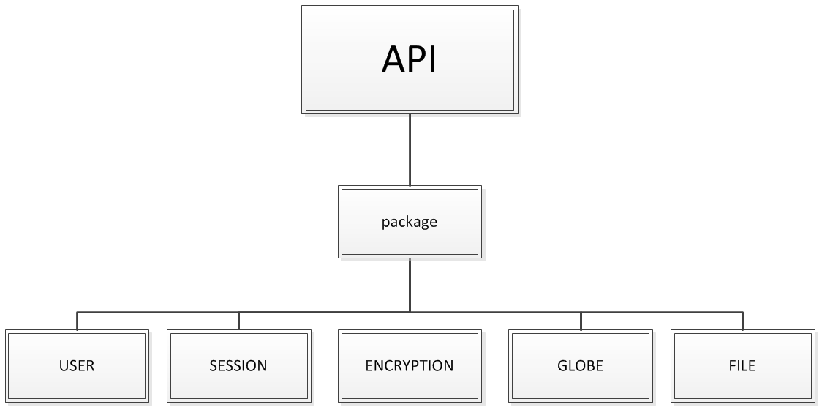
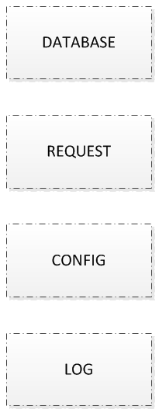
REQUEST
JSON
Notes:
API has a single entry point
Package includes each of the handler and broker
HANDLER
A Handler, has all the functions needed to handle all tasks related to that specific topic
FILE handler is tasked with archiving and publishing files for download
SESSION FOR SESSIONS, ENCRYPTION FOR ENCRYPTION ETC…
What I mean by a BROKER
REQUEST BROKER, maintain all information, variables and functions to successfully handle and return responses
Broker is passed between different handlers, by reference, and is accessed, added to or updated depending on the request
Request Broker also carries out sanitation on all values and encodes itself as JSON for responses back to client requests
Request broker is the key to the success and functionality of the API
Database broker is single point of access for CRUD operations on the database

Slide 31
REFLECTION
Difficulties
Time Management
Serial Comms
Full Testing plan
Notes:
Personally:
Single difficult thing was to manage time
Such an involved project and a wedding/house/new job
Technically:
Could have planned better which would have taken some of the stress out of it
Serial Communcation between the device and PC was flaky, so I had to wrap message comms on the arduino
in what was called a 3 part client object (3PCO) in tech report. Before sending over the serial to the com port on PC.
Client application had to then buffer the serial comms until it received all 3 parts of the message
Iterative approach so unit testing where possible, but wasn’t enough. I would have liked some raw data to illustrate the projects findings, php is also quite difficult to test.

Slide 32
REFLECTION
Future Development
Permissions
Garbage Collection
Full Testing plan
Notes:
Garbage collection for published files, to prevent overflow on the server
initiate a script after each publish to remove the files after a specific time
Individual Permissions and Group permissions on specific files, to really tie down security
Full proper client testing in a working environment

Slide 33
REFLECTION
FUTURE DEVELOPMENT
NFC
Reduce Size
Mobile App
Notes:
Look at 13.56MHz NFC band also to perhaps capture both frequencies in the block device
Reduce the size, ATMEGA chip, boot loader and reader
Matchbox plug direct into usb
Android or IOS app to make use of increasing NFC capable devices

Slide 34
Alex Quigley | 10205691 | BSHCE 4 | Networking & Mobile
Notes:
Questions

